Slide 1



The People Leadership Toolkit
Practical Tools for Stronger Teams

Slide 2

Why this toolkit was developed
The People Leadership Toolkit
Introduction
The People Leadership Toolkit was created to support leadership capability across Aotearoa New Zealand’s construction and
infrastructure workforce. It responds directly to sector research showing that effective
leadership strengthens retention, attraction,
wellbeing, and cultural safety.
The toolkit translates the findings and recommendations from that research into practical tools that help leaders engage more intentionally with their teams. It focuses on the quality of everyday interactions and supports trust-building, development, and consistent team practice.
The toolkit serves as a starter kit – a practical way to begin strengthening everyday leadership. It’s not a checklist or complete solution. Businesses are
encouraged to build from here, adapting the tools to fit their teams, identifying gaps, and drawing on wider sector resources to extend their approach.

Slide 3

Who it’s for
The People Leadership Toolkit
Introduction
This toolkit is for people leaders, supervisors, business owners, and mentors working across construction and infrastructure. It’s designed for anyone responsible for guiding others
– whether through formal authority or everyday influence.
It’s especially relevant for small and medium-sized enterprises that may not have access to structured HR or leadership programmes, but still want to support their teams, retain staff, and build wellbeing in practical, achievable ways.

Slide 4
Why it matters
The People Leadership Toolkit
Introduction
Leadership directly shapes how people experience work, from safety and
communication to whether they stay long enough to grow. Yet across the sector, leadership development is often informal, uneven, or out of reach, especially for
smaller businesses.
This gap has real consequences. Only one in four new entrants stay beyond five years. Many leave not because of the work itself, but because they lack support, mentoring, and clear development pathways.
Supervisors are often promoted for technical skill, not people capability. Without practical tools, they’re expected to lead without guidance, which can affect team culture, confidence, and retention.
This toolkit helps close that gap. It offers low-cost, low-barrier, people-centred resources that leaders can use straight away to check in on wellbeing, build mentoring relationships, and reflect on their leadership in practice.
It is grounded in values such as manaakitanga (care and kindness), whanaungatanga (connection and belonging), kaitiakitanga (guardianship), and tautua (service to others). These principles reflect Māori and Pacific approaches to leadership that prioritise relationships, respect, and collective growth, helping ensure the tools support inclusive and culturally responsive leadership across diverse teams.

Slide 5
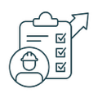


How to use this toolkit
The People Leadership Toolkit
Introduction
Each resource can be used on its own or
alongside the others. There’s no set order – start with what’s most relevant to your role, team, or workplace.
Tool 1
Tool 2
Tool 3
Wellbeing Check-In Guide
Supports regular, open conversations that build connection and care.
Mentoring Template
Supports meaningful career conversations and goal-setting, helping build two-way mentoring relationships where both mentor and mentee learn from each other and share feedback.
Leadership Self-Check Tool
Prompts reflection on strengths, growth areas, and everyday leadership practice.
The toolkit is designed to fit around real work – not add to it. Each tool is short, practical, and ready to use.

Slide 6
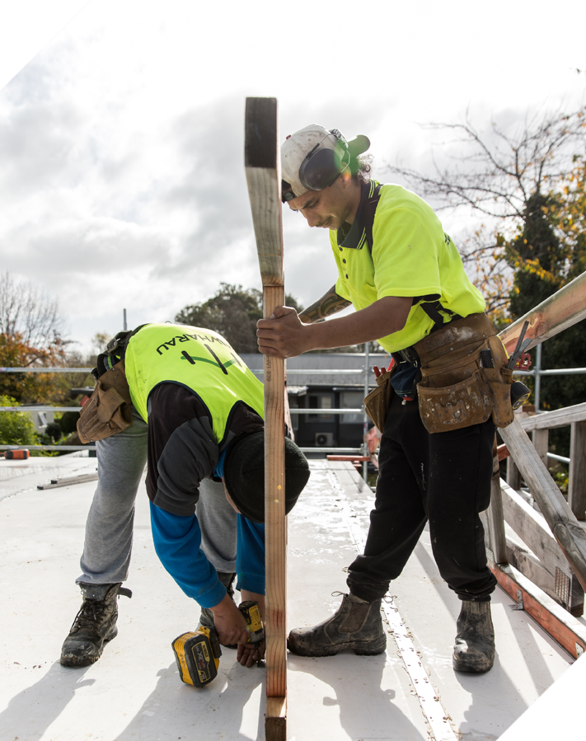
What already exists
The People Leadership Toolkit
Introduction
Many organisations in the sector are already leading strong initiatives in leadership, mentoring, and wellbeing. However, smaller employers often find it harder to access or apply the same approaches consistently.
This toolkit builds on what’s already working. It draws directly from proven initiatives such as Downer NZ’s Te Ara Whanake and Fletcher Building’s Step Up and Whakatapu programmes, which show how intentional, values-based leadership can strengthen retention and cultural capability.
It also reflects wider sector efforts, including:
MATES in Construction and WorkSafe’s Work-Related Wellbeing resources, which support mental health and psychological safety.
HEB Construction, Fulton Hogan, Livingstone Building, and Naylor Love, which use mentoring and cadetship models to transfer knowledge and build confidence.
Māori and Pasifika Trades Training and the Māori Trades Training Fund, which demonstrate the value of culturally grounded, whānau-centred leadership.
Pasifika Trades Training and the Pacific Workforce Development Plan, which show how community-based support builds belonging and long-term participation.
By bringing these examples together, the toolkit
makes proven practice more accessible and adaptable for employers of every size.

Slide 7
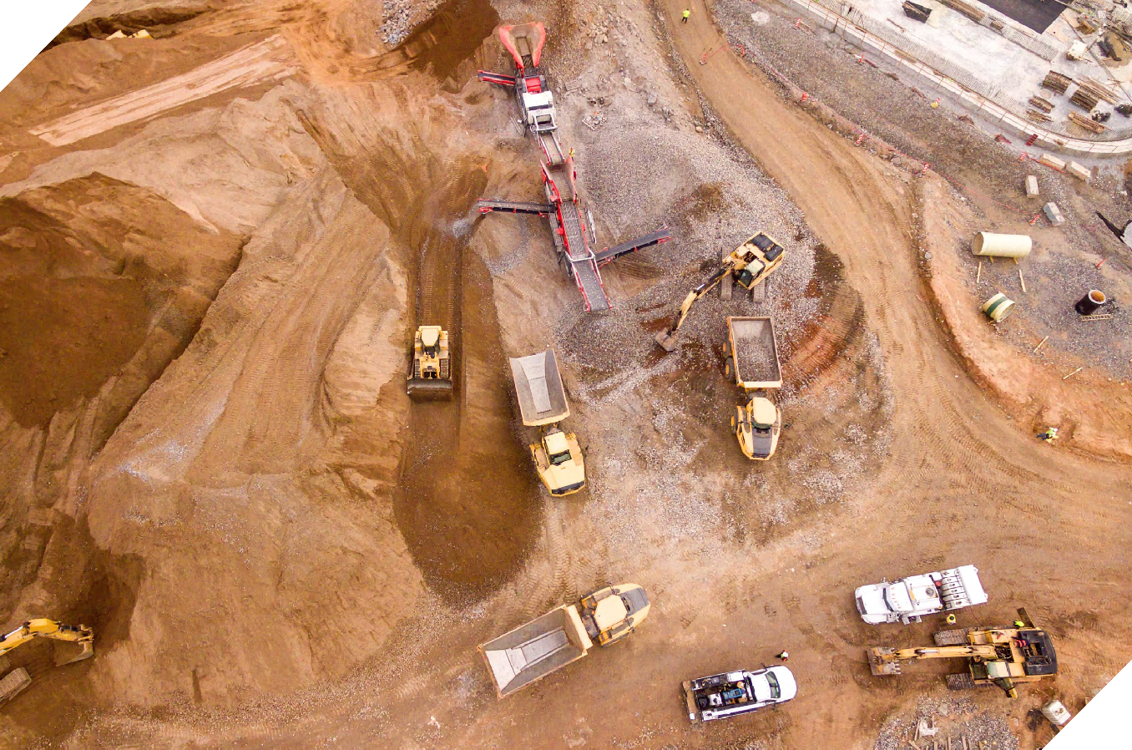
What happens next
The People Leadership Toolkit
Introduction
The following sections introduce each tool in detail and show how they can be used in practice.
Each one includes short prompts, templates, or reflection questions to help leaders and mentors turn sector research and recommendations into everyday approaches that build consistent habits of reflection, care, and communication.

Slide 8

Wellbeing Check-in Guide
Tool 1

Slide 9
The People Leadership Toolkit
Tool 1: Wellbeing Check-in Guide
Purpose
Why it matters
Wellbeing Check-in Guide
This guide helps leaders and mentors embed wellbeing into how they lead and connect with their teams. It supports conversations that foster open communication and psychological safety through simple, genuine check-ins.
The sector has called for approaches that are simple to use and focused on real outcomes for people.
Consistent, empathetic communication makes a real difference to morale, safety, and retention.
Embedding wellbeing within leadership practice supports both safety and performance by recognising that health, wellbeing, and productivity are connected. This tool complements existing sector initiatives by giving leaders and mentors a clear, practical way to lead with care, whether on site, in an office, or remotely.
When leaders listen and follow up, it builds genuine relationships and confidence. Empathetic leadership helps people feel valued and connected, and small actions that show care make a lasting difference to wellbeing.
Work can be demanding. Long hours, shifting workloads, and tight deadlines are common. A short conversation can often do more to show support than a formal meeting. It reminds people they are seen and valued, not just supervised.
Wellbeing leadership is not about being an expert – it’s about being human. Leaders who show values like whanaungatanga (connection and relationships), manaakitanga (care and respect), tautua (service to
others), and kaitiakitanga (guardianship) see the whole person, including their whānau (family) connections and life outside of work. Bringing these values into everyday practice helps create inclusive, steady workplaces where people want to stay.
By taking this approach, leaders reduce the pressures that contribute to stress and disengagement. They can recognise good work, involve teams in wellbeing decisions, and address issues early. These skills help grow a connected and capable workforce that’s ready for what’s ahead.
1

Slide 10
The People Leadership Toolkit
Tool 1: Wellbeing Check-in Guide
Use this guide to shape short, meaningful wellbeing conversations that fit naturally into daily work. It can be used one-on-one, in team catch-
ups, or during meetings. The aim is to build trust and connection while giving people room to talk about how they are doing.
1. Prepare
2. Start the Conversation
Choose a time and place where the person feels comfortable and not rushed. Keep it relaxed, for example before work starts, between meetings, or over coffee.
Take a moment to check in with yourself first.
Be present, listen fully, and set aside distractions.
Begin with a simple question such as
“How’s everything going for you lately?”
Ask open questions that encourage reflection:
“Has anything been getting in the way for you at work?”
“How’s life outside of work been?”
“Tell me a bit about how your workload’s been lately”
“How’s everything going with the team?”
Let the conversation flow naturally. Give people time to think before they respond.
Reflection: Think about how you can make this kōrero (conversation) positive and respectful, so that the person feels valued and supported.
You might draw on values such as manaakitanga (care and kindness) and whanaungatanga (connection and belonging), which sit at the heart of inclusive and culturally grounded leadership.

Slide 11
The People Leadership Toolkit
Tool 1: Wellbeing Check-in Guide
3. Listen and Notice
4. Follow Up
5. Lead by Example
Pay attention to what’s said and what’s not. Show genuine interest and empathy. Avoid rushing to solve problems unless the person asks for help; often listening is the most powerful thing you can do.
Check back in later with a simple “How are things going with that?” Keep notes only if necessary and respect privacy.
If the issue feels bigger than your role, connect them with the right support, for example, MATES in Construction (0800 111 315), Need to Talk? (1737), or another trusted contact or community service. A follow-up shows care and builds trust. Even a brief check-in can make a difference.
Model healthy habits such as taking breaks and finishing on time. Recognise effort and good work. Keep wellbeing on the agenda at team meetings or one-on-one check-ins, and talk about what helps you manage stress or balance your workload. Share what’s helped you personally; it normalises these conversations for others.
Consider how your actions demonstrate values such as tautua (service) and kaitiakitanga (looking after the
wellbeing of others). Leading with these principles helps create trust and connection across diverse teams.
Reminder: People experience wellbeing challenges in different ways. What affects someone on site may differ from someone in an office, but everyone needs to feel heard and supported.
Reflection: After each check-in, note one small action you’ll take or one thing you learned about your team. Over time, these small actions build stronger communication and trust.
11

Slide 12
Tips, tricks and support
The People Leadership Toolkit
Tool 1: Wellbeing Check-in Guide
How to get the most from this tool – add it to your kit and know where to go for extra support.
Tips For Leaders
Adding to your kit
Support
Start small. A few minutes of genuine attention can make a real difference.
Be consistent. Regular check-ins build trust faster than one-off talks.
Share your own experiences. It normalises looking after ourselves and each other.
Talk with other leaders. Exchange what’s working and learn from peers.
Integrate check-ins. Link them to existing health, safety, or mentoring routines.
How does this tool add value?
It gives leaders a simple, repeatable way to embed care into everyday work.
By making wellbeing part of routine conversations, it helps normalise support, reduce stigma, and build stronger team connection.
The guide also helps leaders model values-based practice in real time – not just talk about it.
For more ideas and sector resources that support wellbeing and leadership conversations:
MATES in Construction – 0800 111 315
Need to Talk? 1737 – Call or text 1737 for free support
WorkSafe NZ – Work-related Wellbeing: What Good Looks Like
Site Safe NZ – Mental Health and Wellbeing
| SiteSafe
For additional sector resources, see
Appendix A.

Slide 13

Mentoring Template
Tool 2

Slide 14
The People Leadership Toolkit
Tool 2: Mentoring Template
Purpose
Why it matters
Mentoring Template
This template helps leaders and mentors build consistent, two-way mentoring relationships that support growth, confidence, and capability across every role in the construction and infrastructure sector.
It can be used with apprentices, new starters, experienced tradespeople, or office-based staff, essentially anyone developing in their role or preparing for the next step.
It recognises that mentoring in New Zealand draws on many traditions of guidance and support, including tuākana–teina relationships that value reciprocity, respect, and collective growth.
Employers have emphasised the need for consistent, structured support for knowledge transfer through mentoring and role-modelling. Structured mentoring helps people settle faster, learn the culture, and see clear development steps.
Making mentoring a standard part of how new people are welcomed into a company strengthens early connection and confidence. Embedding it as routine practice supports consistent development across all roles and teams.
It also supports the transfer of practical and cultural knowledge within teams, building capability and connection, and improving retention and confidence.
Evidence shows that people stay longer when they feel supported and can see a path for development. Many employers want to mentor but are unsure how to begin or maintain a consistent approach.
This tool helps employers and mentors set up and sustain mentoring in a consistent way, encouraging reflection and shared learning between mentor and mentee.
2

Slide 15
The People Leadership Toolkit
Tool 2: Mentoring Template
Use this template to guide your mentoring relationship. It helps mentors and mentees agree on
purpose, goals, and progress, and supports meaningful conversations throughout the mentoring period.
Both mentor and mentee can complete
and share this form to stay aligned on goals, expectations, and progress.
Mentoring also supports succession planning by helping experienced staff pass on knowledge and prepare others for leadership. This makes
it a valuable tool for growing future capability across teams and roles.
Step 1 – Purpose of this mentoring relationship
Mentoring relationships grounded in values such as manaakitanga (care and kindness) and whanaungatanga (connection and belonging) foster trust, reciprocity, and inclusive leadership.
Why are we doing this? What does each person hope to gain (for example, confidence, wellbeing, connection, or career growth)?
If relevant, note any shared values or cultural principles (e.g. whanaungatanga, tautua (service to others), manaakitanga) that guide your mentoring relationship.
Mentoring details
Mentor:
Mentee:
Date started:
Role / Team:

Slide 16
The People Leadership Toolkit
Tool 2: Mentoring Template
Step 2 – Goals we’re working on
Step 3 – Meeting record / notes
List two or three goals linked to real work, leadership confidence, or development on the job. Note how this mentoring relationship supports everyday leadership and collaboration in your work.
Plan regular catch-ups (weekly or fortnightly early on) to keep momentum and support learning. Use this to capture key points from each conversation.
Goal | Why it matters | How we’ll know progress | Target date
e.g., Improve confidence speaking up in team meetings
Date | Focus topic | Key insights / discussion points | Agreed next steps

Slide 17
The People Leadership Toolkit
Tool 2: Mentoring Template
Step 4 – Mid-point reflection
Step 5 – Final reflection
Step 6 – Mentor and Mentee sign-off
Halfway through the mentoring period, check in together:
What’s working well?
What needs to change?
What have we each learned so far about our work, leadership, or how we collaborate?
How have we shown respect, reciprocity, and care, for example through manaakitanga or tautua, in our mentoring relationship?
At the end of the mentoring period, reflect on the experience:
What’s changed since we started?
How has each of us developed?
What’s next for the mentee’s growth?
What feedback do we have for each other?
How might this mentoring relationship contribute to future leadership or succession within your team or organisation?
What have we learned about leadership through cultural values such as whanaungatanga and fa’aaloalo (mutual respect)?
Both sign here to acknowledge what was gained from this mentoring experience and how it contributes to future capability or leadership development.
Mentor signature:
Mentee signature:
Date:

Slide 18
Tips, tricks and support
The People Leadership Toolkit
Tool 2: Mentoring Template
How to get the most from this tool – add it to your kit and know where to go for extra support.
Tips for mentors & mentees
Adding to your kit
Support
Build trust early and be reliable.
Listen more than you talk.
Keep goals realistic and linked to real work.
Share responsibility for progress.
Reflect regularly – growth is a two-way process.
Encourage others to mentor new team members too.
How does this tool add value?
It turns mentoring from an informal intention into a structured, shared process.
Leaders and mentors can use it to set clear goals, track progress, and reflect together – making mentoring more consistent across roles and teams.
It also helps build a culture where development is expected, supported, and visible.
For more ideas and sector examples that can support mentoring and career development:
Ako Whakaruruhau Tuākana Mentor Handbook Guidance on tuākana–teina mentoring approaches and culturally grounded support.
BCITO – Leadership & Mentoring Resources Practical mentoring and leadership tools for construction and infrastructure workplaces.
Māori and Pasifika Trades Training (MPTT) Culturally grounded mentoring and leadership pathways.
For additional sector resources, see
Appendix A.

Slide 19

Leadership Self Check Tool
Tool 3

Slide 20
The People Leadership Toolkit
Tool 3: Leadership Self Check Tool
Purpose
Why it matters
Leadership Self Check Tool
This tool helps leaders reflect on how their actions and decisions affect their teams. It supports self-awareness and ongoing improvement in key areas highlighted through sector engagement – communication, inclusion, wellbeing, and team culture.
It can be used by anyone with formal or informal leadership responsibilities and offers a straightforward way to pause, assess, and plan how to strengthen everyday practice.
Sector evidence shows that leadership behaviour directly influences how supported and valued people feel at work.
Workers who experience consistent, respectful, and communicative leadership are more likely to stay, engage, and perform well.
Many leaders want to strengthen how they lead but lack practical ways to reflect or apply learning consistently.
This tool makes that process achievable. It focuses on reflection across the core leadership
capabilities identified in the sector findings: listening, communicating clearly, showing care, modelling respect, and practising inclusion.
Regular use helps leaders identify what’s working well, where they can grow, and what small actions could make the greatest difference for their teams.
3

Slide 21
The People Leadership Toolkit
Tool 3: Leadership Self Check Tool
A way for leaders to reflect on how they lead and strengthen their practice.
This tool is designed to help leaders reflect on their impact and strengthen everyday practice.
How to use this tool
Use this tool to reflect on how your leadership shows up day to day.
You can complete it on your own or discuss it with a mentor, supervisor, or peer.
Be honest – the goal is growth, not evaluation.
Step 1 – Reflect on your current practice
Leadership behaviour | 1 | 2 | 3 | 4
I communicate clearly and regularly with my team.
I make time to check in and listen to how people are doing, not just what they are doing.
I know my workers well – their strengths, interests, and what matters to them outside of work.
I act in ways that build trust and reliability.
I recognise effort and give feedback that helps people grow.
I take time to understand what matters to each person – their strengths, goals, and how they like to work.
I help people build confidence in their broader skills such as teamwork, communication, and problem-solving.
I support inclusion and respect for diverse backgrounds and views.
I demonstrate manaakitanga (care and kindness) and whanaungatanga (connection and belonging) in my everyday leadership.
I seek and value Māori and Pacific perspectives when making decisions that affect others.
I respond calmly and fairly to challenges or mistakes.
I encourage others to share ideas and take the lead where possible.
I actively support wellbeing and balance in my team.
I seek feedback on my own leadership and act on it.
Rating: 1–4
Meaning: 1 = Rarely happens, 4 = Consistently happens

Slide 22
The People Leadership Toolkit
Tool 3: Leadership Self Check Tool
Step 2 – Reflect on what this means
Step 3 – Plan one action for improvement
What are the top two areas you do well?
What are two areas you want to strengthen?
Choose one small action to focus on over the next month.
Be clear about what you will do, why it matters, and how you will know it made a difference.
Focus area | Action | Why it matters | How I will track progress | Review date
Consider how your leadership reflects values such as tautua (service to others) and kaitiakitanga (guardianship and responsibility). What examples show these in practice?
Team feedback (optional)
Once you’ve reflected on your own leadership, consider asking one or two team members:
What helps you feel supported at work?
Is there anything I could do differently as a leader?
Use their feedback to guide your next action. This helps build trust and shows you’re open to learning.

Slide 23
Tips, tricks and support
The People Leadership Toolkit
Tool 3: Leadership Self Check Tool
How to get the most from this tool – add it to your kit and know where to go for extra support.
Tips For Leaders
Adding to your kit
Support
Know your people. Genuine connection builds trust and helps spot challenges early.
Complete the self-check every few months to see progress over time.
Ask for feedback from your team or mentor; others often see things we miss.
Use your reflection to guide professional development goals.
Keep notes to recognise patterns or improvements across projects or teams.
Reflect regularly. Even 15 minutes a week strengthens self-awareness.
How does this tool add value?
It gives leaders a practical way to pause and assess how their behaviour affects others.
The tool supports regular reflection without needing formal training or external facilitation.
Over time, it helps leaders build intentional habits that strengthen team culture and personal accountability.
For more ideas and sector examples that can support leadership reflection and development:
“Seeing the person” tool in the MJ toolkit.
Fletcher Construction – Step Up and Whakatupu leadership programmes
Downer NZ – Te Ara Whanake Māori Leadership
Scafit – People-centred leadership and wellbeing approach
For additional sector resources, see
Appendix A.

Slide 24

Looking Ahead
The People Leadership Toolkit
Looking Ahead
The People Leadership Toolkit is intended to evolve through everyday use. As people leaders, supervisors, and business owners apply the tools in their workplaces, they are encouraged to share what’s working and what they’ve learned with others.
By sharing experiences and insights, businesses can help keep these resources relevant, practical, and grounded in real examples of effective people leadership across the sector.

Slide 25
Appendix
The People Leadership Toolkit
Appendix
Appendix A provides additional sector resources that complement the three tools in this toolkit. These include wellbeing, mentoring, and leadership self-reflection materials that can support everyday people-leadership practice.
Tool 1 – Wellbeing Check-In Guide
BCITO – Wellbeing Support – Practical tips and contacts for supporting apprentice and team wellbeing.
MATES Toolbox 2022 (PDF) – Easy-to-use mental health toolbox sessions designed for construction crews.
“Your people question sheet” tool in the
Worker Support Practice Toolkit (ConCOVE Tūhura and Waihanga Ara Rau, 2025, p.11-12) – Encourages leaders to understand each person’s background, values, and needs, and to look beyond performance when checking in.
Employer Apprenticeship Toolkit (Allen + Clarke, 2025) – Provides a structured wellbeing check-in template employers can use for open, supportive conversations with apprentices.
Tool 2 – Mentoring Template
Building Wellness – Mentor Mates –
Peer-mentoring initiative promoting wellbeing and connection across the sector.
Good Employer Matrix – Practical benchmark for inclusive and people-centred employment practices.
Te Ara Whanake – Downer NZ Māori Leadership Programme – Values-based leadership and mentoring development grounded in Māori principles.
Tool 3 – Leadership Self-Check Tool
Leadership styles and when to use them –
Business.govt.nz – Helps leaders reflect on which style they use most and whether it suits their team and situation
Being a Good Leader – Outlines the everyday leadership behaviours that build trust, communication, and positive team culture

Slide 26


