Slide 1

Provider-Based Kaiako Onboarding Toolkit
Empowering provider-based Kaiako in Aotearoa’s VET system to be the best they can be as educators of our ākonga

Slide 2
Our kaiako are critical to the quality of provider-based vocational
education in Aotearoa. We need to better support people in their transition from industry to becoming educators.
Let’s acknowledge that the transition into the role of a kaiako is substantial in many ways and provide adequate support, time, and energy for this……create highly practical development tools to support the initial transition with other tools to support more advanced practice over the longer term; and treat the current transition to kaiako as substantial whilst also looking at ways to make the learning curve a bit smaller.
Provider-Based VET Kaiako Development Pathways: Exploring the ways Kaiako are Supported and Developed, Skills Group, August 2024
“

Slide 3
More effective onboarding and
development pathways set the foundations for a Kaiako’s success
How might we onboard technically competent Kaiako into the education provider environment?
ConCOVE’s and Food Fibre CoVE’s research through the Skills Group identified eight barriers to effective Kaiako development and five key areas of change. The research is here as background reading for this toolkit.
ConCOVE wanted to activate the research by working closely with several VET providers to develop and test onboarding tools to support them to support their Kaiako.
The aspiration is that VET providers have an onboarding toolkit that fits with their strategic intent, is valuable for the Kaiako, and feasible and viable for the provider to implement consistently.
The diversity of VET providers means that the best toolkit is bespoke. Therefore, this work has created the toolkit to create a compelling experience that any provider could use with confidence.
This is a design toolkit that enables a provider team to map out a compelling experience for their arriving Kaiako that integrates onboarding and professional development.
The compelling experience framework, originally developed by the Doblin Group, has been adapted for this work to cover four phases: 1. Contracted, 2. Entry, 3. Immersion, and 4. Extension. The experience design is informed by meaningful outcomes for the Kaiako and the provider, and by experience first principles. Additionally phase specific needs and phase transition mindsets help focus thinking at particular moments in the experience.
This toolkit has been tested in live situations with several providers. This framework is located here in an editable format. The development of the toolkit was facilitated by Martin Grant.
Meaningful Outcomes
KAIAKO AND ORGANISATION
Experience First Principles
Contracted
PRE-START
Entry
FIRST WEEK
Immersion
PRIMARY ONBOARDING & PROF DEVELOPMENT
Extension
ENABLED TO GO FURTHER

Slide 4
Kaiako Compelling Experience design process overview
This toolkit takes a user centred design approach, also sometimes to referred as design thinking.
The nine-step process starts with a cross team collaborative co-design workshop held over four hours. It is best to involve the Kaiako Capability, People and Culture and Teaching Programme teams in the workshop.
Following the workshop an artefact captures the work and then small scale safe-to-fail pilots are deployed with a learning mindset.
Before you start:
Print the worksheet pack A4 to use during the session to recreate on whiteboards.
Select a room that has plenty of whiteboards.
Assemble Post-it notes, felt pens and blutac.
1
Articulate your view of meaningful outcomes and first principles to inform the design process.
~90 minutes
2
Use the Kaiako persona to see the world through their eyes and walk in their shoes (have empathy).
3
Map the current experience to see ‘what is’.
Co-Design Workshop
4
Identify green-shoot ideas that are being tried in pockets in the organisation.
~60 minutes
5
Take a divergent mindset exploring new ideas without judgement or assessment.
6
Take a convergent mindset using multi-factor assessment to prioritise ideas.
~60 minutes
7
Create a compelling experience map as a touchpoint for the teams that support the Kaiako.
8
Deploy several small scale safe-to-fail pilots and seek feedback from the Kaiako and the organisation.
9
Iterate and scale ideas that meet Kaiako and organisation outcomes.

Slide 5
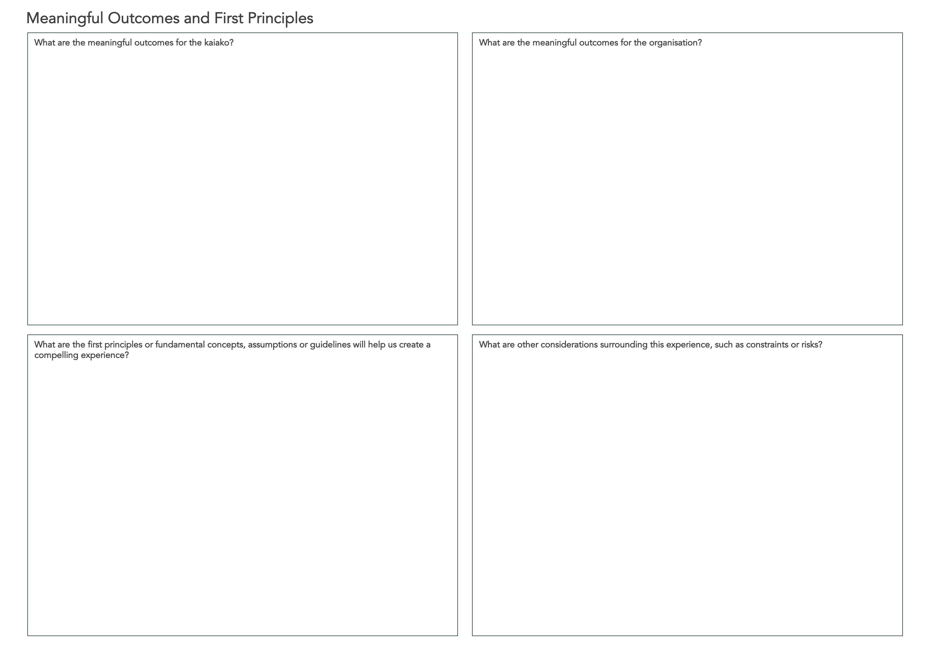
Meaningful outcomes and first principles
Being clear on the outcomes for the Kaiako and the organisation ensures the experience delivers on multiple levels.
First principles, also known as design principles, are the fundamental concepts, assumptions or guidelines that help us create compelling experiences.
It is also useful to capture other considerations at this stage.
Instructions:
Recreate the Meaningful Outcomes and First Principles worksheet on a whiteboard.
For a small group work together to complete the questions capturing on Post-it notes. In a large group work in 3s or 4s assigning one section to each group.
At the end of the conversation remove duplicates, cluster the Post-its into groups and create summary notes.
Keep visible during the rest of the process.
1

Slide 6
Use the Kaiako persona to see the world through their eyes and walk in their shoes.
When we see the world through someone else’s eyes or walk in their shoes we can better understand what they are thinking, feeling and needing. We have empathy for their situation.
Instructions:
Print several A3 copies of the persona for people participating in the workshop.
Through the process constantly, stop and ask yourself, “what would Mike be thinking or feeling about this?”
Note: You can create personas for others in the experience if you wish ahead of the design process, for example the Kaiako’s line manager.
2

Slide 7
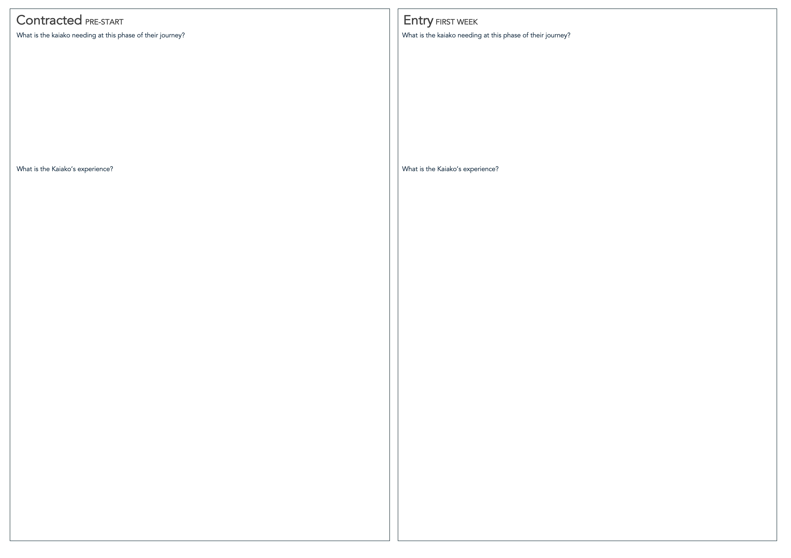
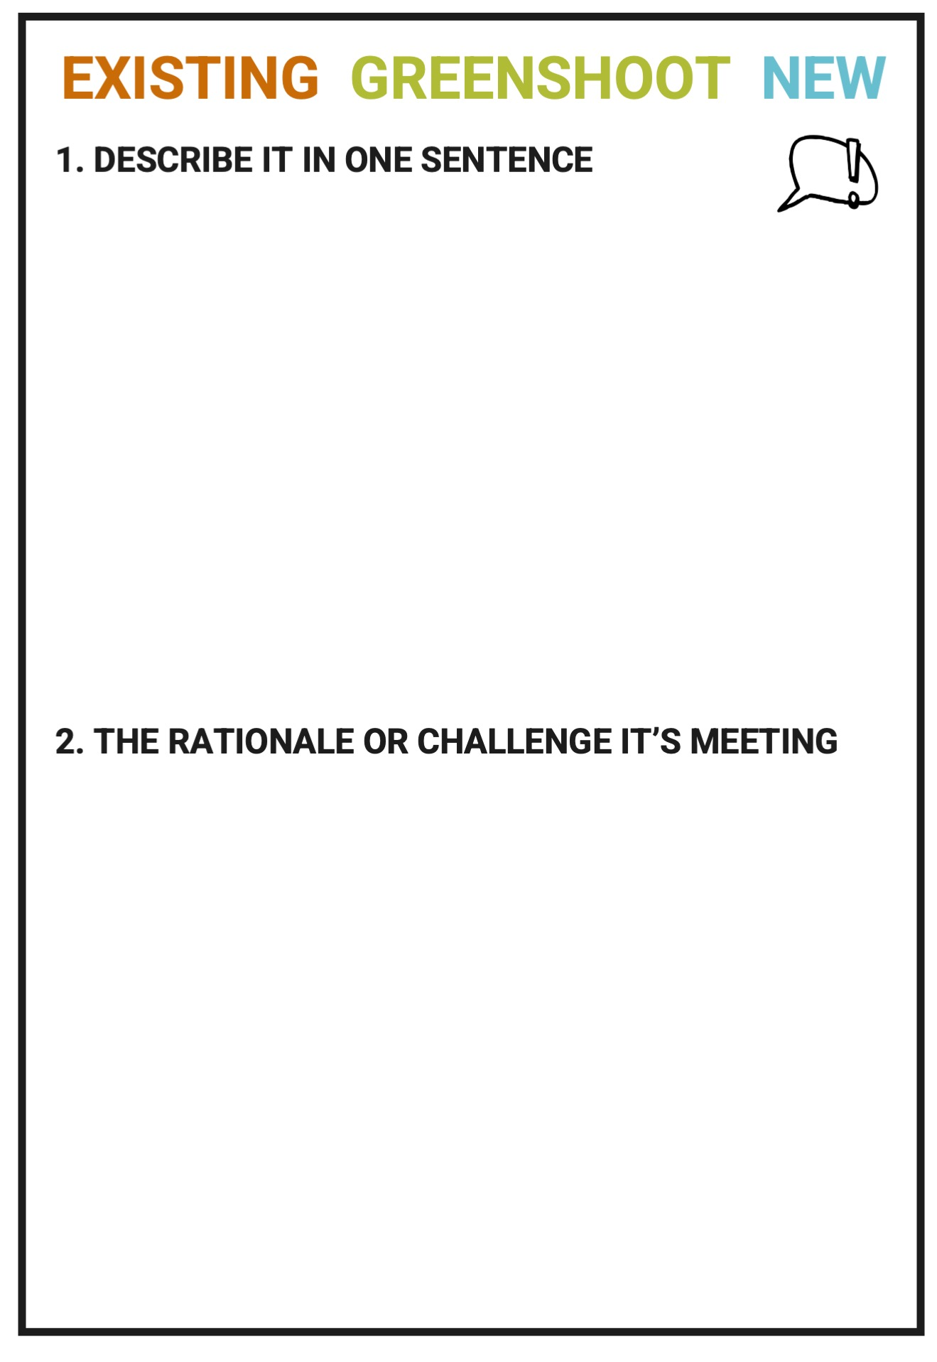
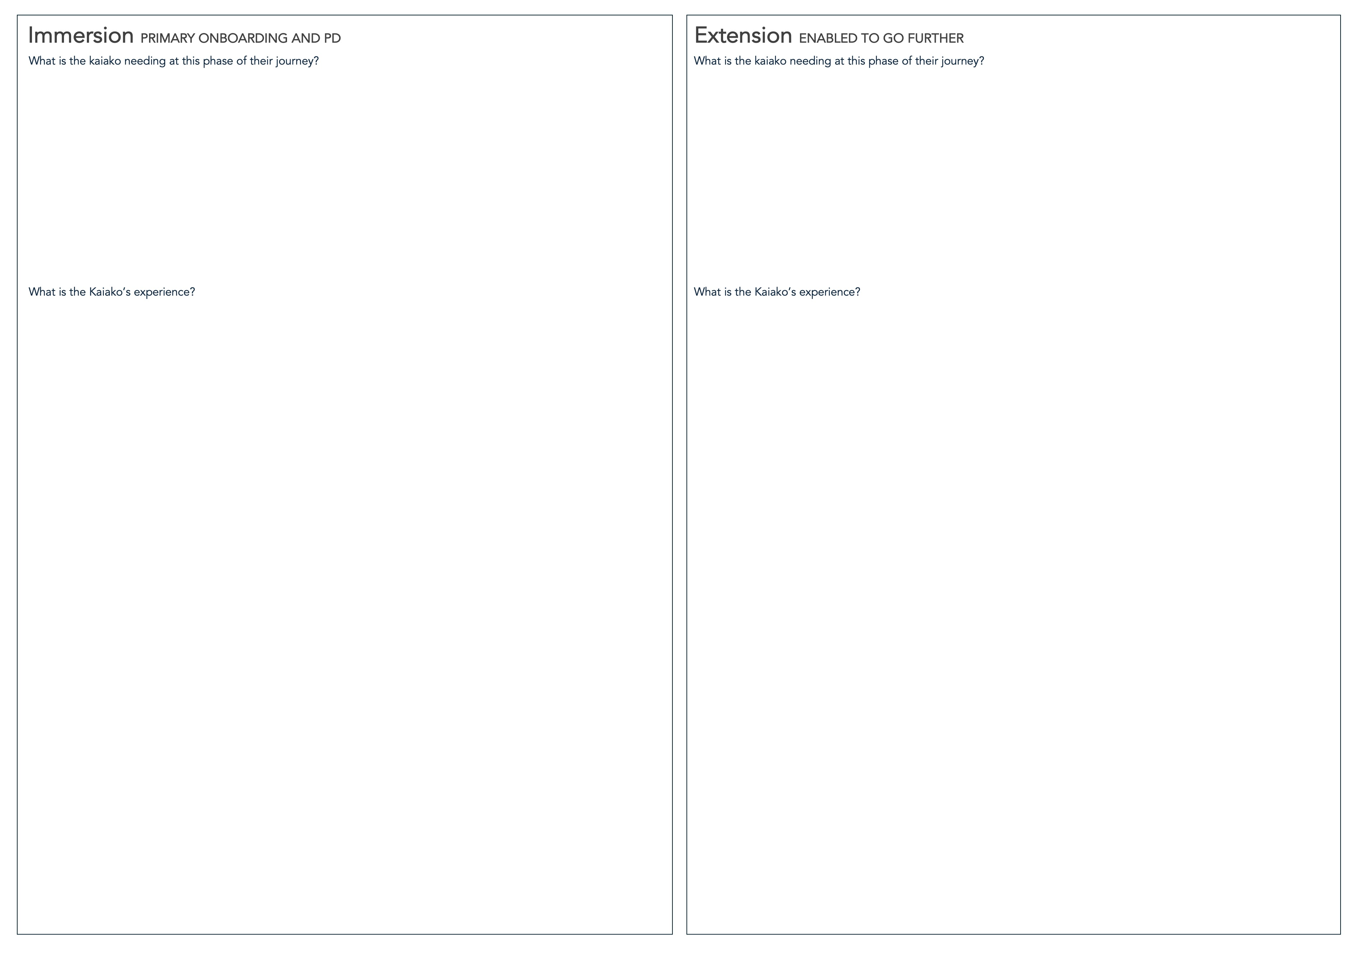
Map the current experience to see what is existing and the greenshoots
We want to start with ’what is’ the current experience for the Kaiako. This will include the things done all the time with everyone. But we also want to capture what people are trying. We call these ‘greenshoots’ as they are possible signals of good things that might be worth scaling.
Instructions:
Print 20 copies of the sheet from the worksheet pack with the four cards on it on 120gsm paper and cut up.
Recreate the Experience Phase sheets on a whiteboard.
Start by capturing the needs of the Kaiako and the organisation for each phase using Post-its. Also capture the desired mindset for the Kaiako as they transition from one phase to the next.
Then capture everything that happens in each phase around onboarding and developing a professional development plan for the Kaiako. Capture one thing per card. Circle either existing or greenshoot on the card. Blutac onto the relevant Phase.
3
4

Slide 8
Adopt a divergent mindset exploring new ideas without judgement
We want to explore all the possible things we could do to deliver the meaningful outcomes and meet the needs for the kaiako and the organisation. We want to suspend judgement for a time, so we are unconstrained in our thinking.
Instructions:
Use the idea cards and in pairs or small groups generate new ideas. Circle as such on the card.
Blutac onto the relevant Phase.
When you have run out of ideas, look at all the ideas and remove duplicates. Also ensure the idea and the challenge it is meeting is clear.
Take a photo of each of the experience phases in order to create the compelling experience artefact.
5

Slide 9
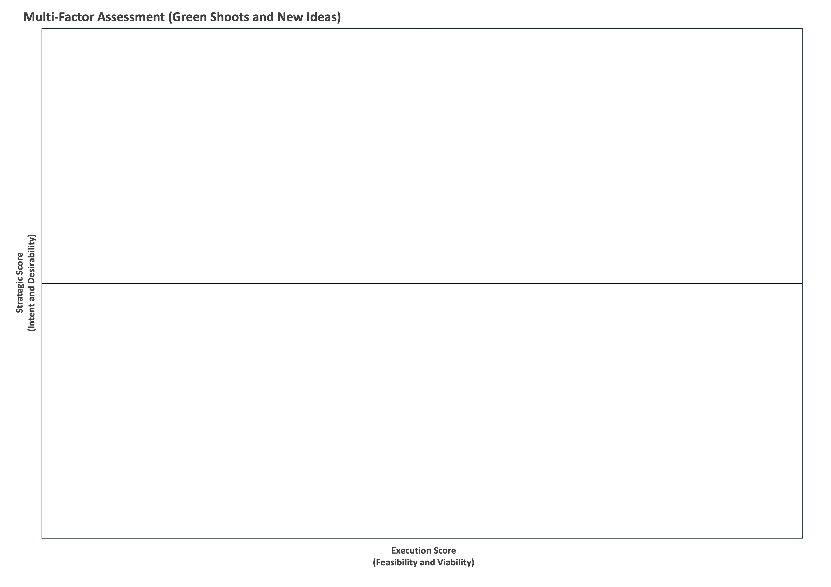
Adopt a convergent mindset and use the IDVF framework to prioritise green shoots alongside new ideas.
We always have more ideas than we have resources to implement. The IDVF framework is a good way to make choices by assessing alignment with organisation Intent, Desirability for the user, Feasibility to execute and financial Viability.
Instructions:
Recreate the multi-factor assessment worksheet on a whiteboard
Transfer your greenshoot ideas and new ideas to the 2x2 matrix by thinking about relative merit between ideas.
It is helpful to place the cards vertically first up the left axis to reflect relative strategic merit. Then move them horizontally to reflect executability merit.
There is an IDVF excel file here if you want to score the ideas more accurately.
Strategic Assessment Factor Detail
Intent: Alignment to organisation goals and strategy
Desirability: Value to the kaiako meeting known and unknown needs.
Execution Assessment Factor Detail
Feasibility: Organisation has the capability and capacity to execute and deliver consistently into the future.
Viability: Cost to build and operationalise
6

Slide 10
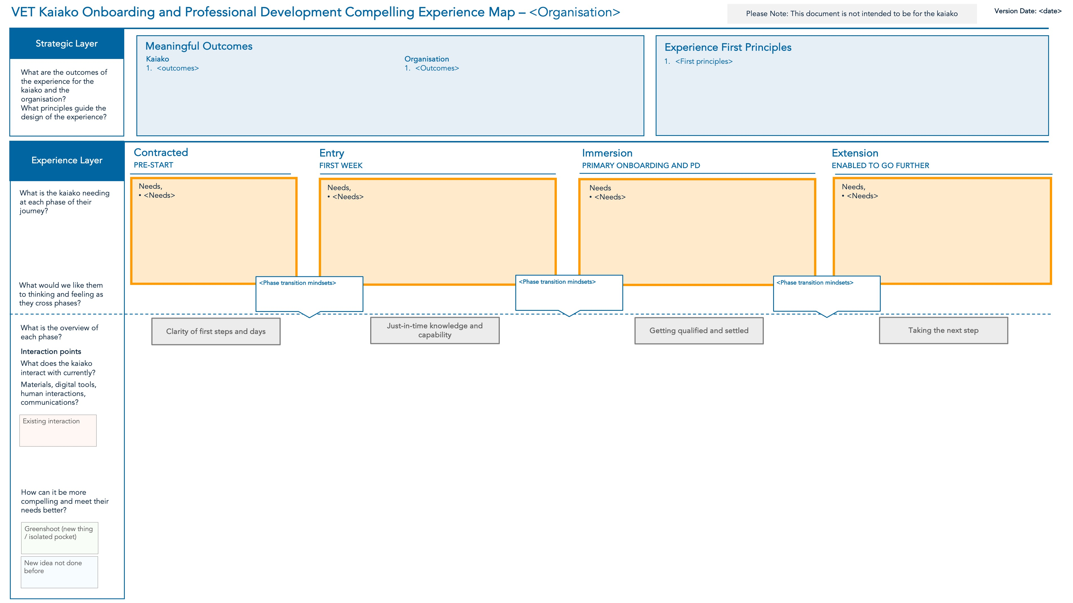
Create a compelling experience map as a touchpoint for all the teams.
A shared artefact is useful to capture the work of the co-design group.
The compelling experience map has spaces for all the content created during the co-design workshop.
Instructions:
The Experience Map editable file is here.
Print several A3 copies so workshop participants have a view to the final artefact.
See the next page for a completed experience map from one of the providers who tested this toolkit.
7

Slide 11
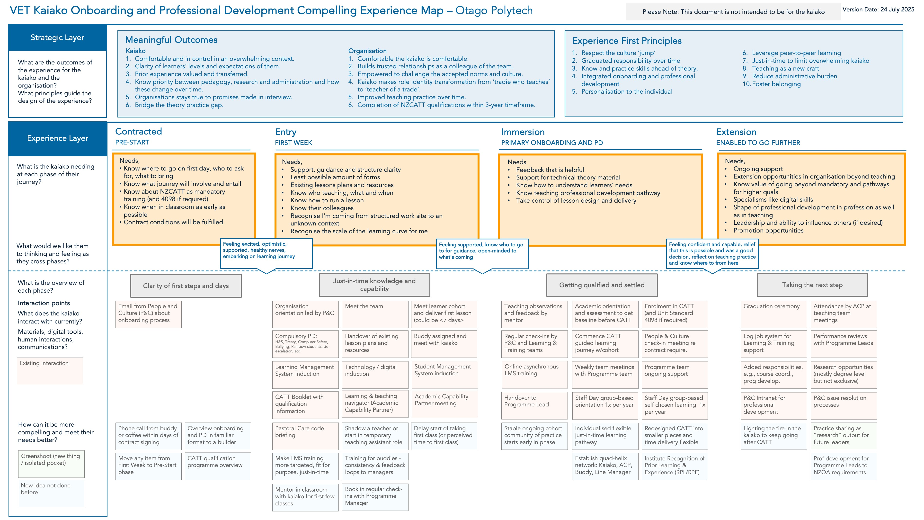
Note: Idea prioritisation has not been shown for commercial reasons.

Slide 12
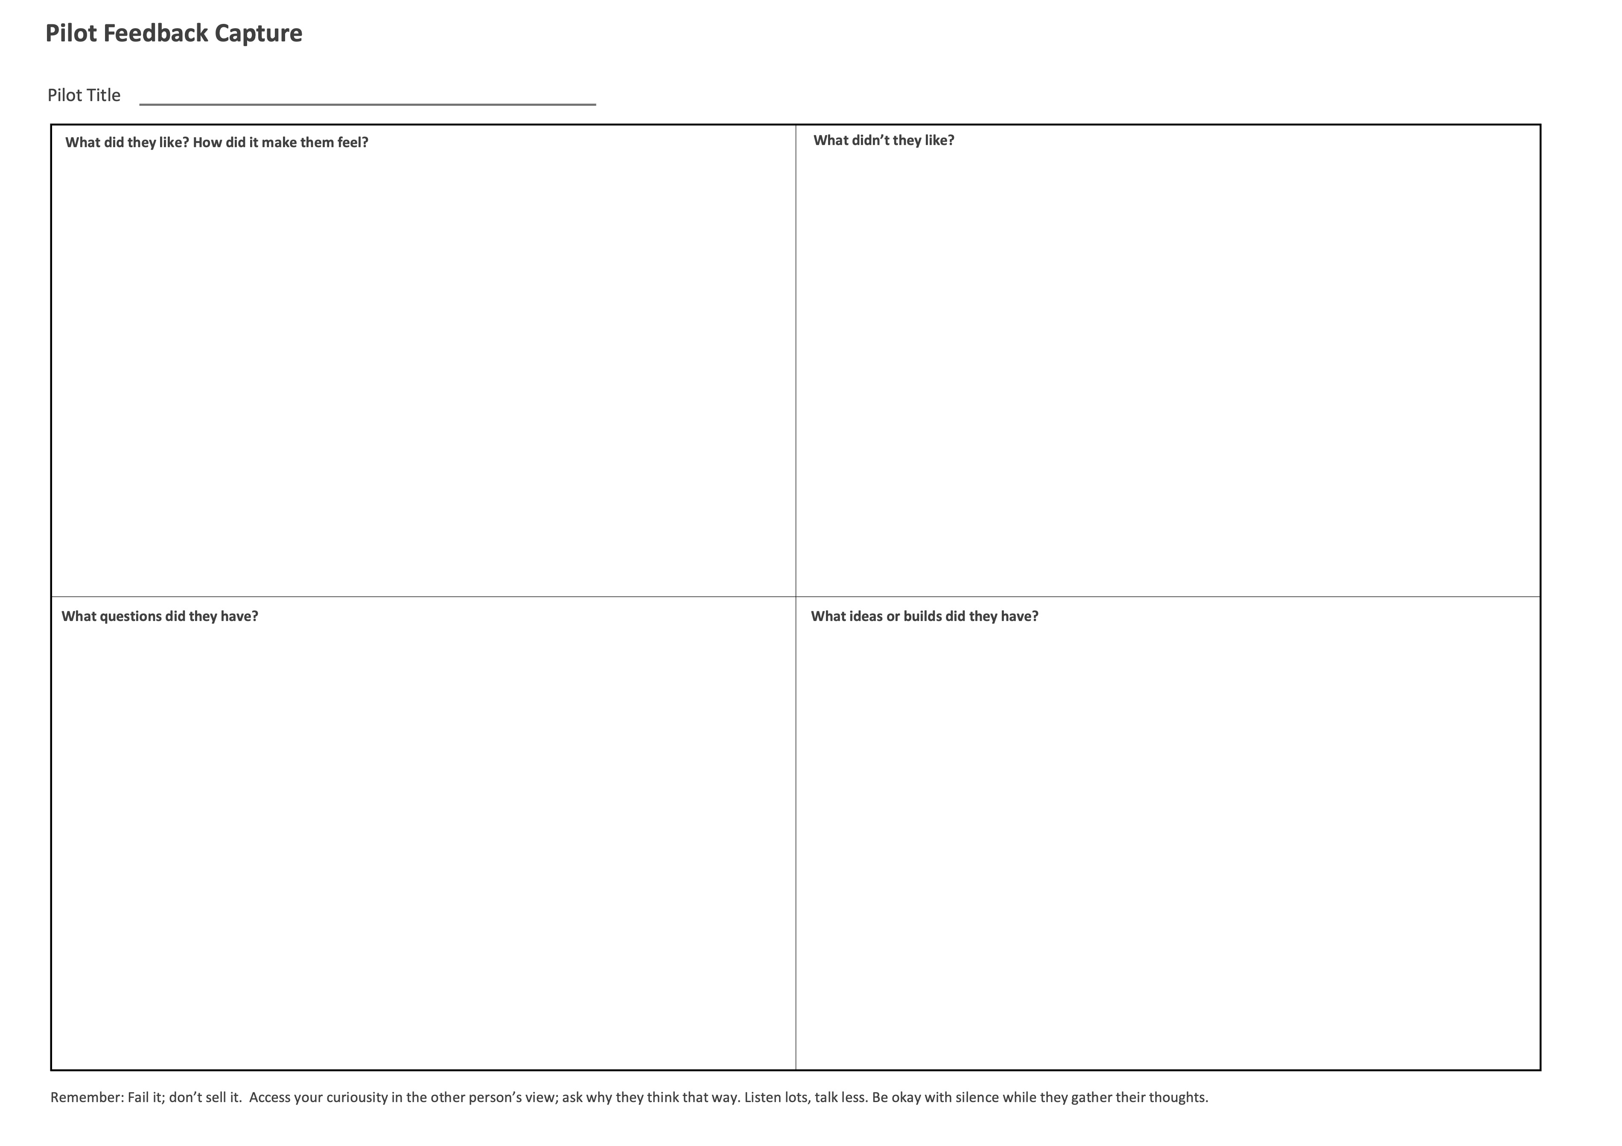
Deploy small scale safe-to-fail pilots and seek feedback before scaling.
A piloting process enables improvement to an idea based on users’ real-world experiences. Equally, it enables decisions to stop ideas that won’t ever work as intended. All together this means you can deploy and scale with more confidence.
Instructions:
Take the a priority ideas from the IDVF assessment and develop any details necessary to rapidly execute them with minimum viable resources.
Let the idea happen then interview people involved and capture feedback on Pilot Feedback Capture worksheet.
Reconvene as a group to decide for each idea: Scale it? Iterate it? Kill it?
8
9

