Slide 1



Inspiring the next generation
An industry-school engagement Starter Kit for small- and medium-sized employers.

Slide 2
Inspiring the next generation
2
Contents
03 08
18
Introduction
Part 1 | Understanding the gap between school and work for students
Part 2 | The 5 steps to successful engagement
Step 1 | Finding your best entrypoint
Step 2 | Starting well with schools
Step 3 | Getting to ‘yes’
Step 4 | Making it happen
Step 5 | Engaging well with students
36 41
Helpful tools and guidance
Conclusion

Slide 3
Inspiring the next generation
3
Introduction
Part 1 | Understanding the gap Part 2 | Successful engagement Helpful tools and guidance Conclusion
Introduction
This Starter Kit contains practical and adaptable guidance, plus tools to equip employers to confidently and effectively partner with schools to engage with their students and help connect them with the world of work.
Who is this for?
Current and potential
employers, looking for
the next generation
of workers.
Businesses that want to promote their industry to help it grow.
People who want to give back to their communities by inspiring young people.
Industry associations and advocacy and support organisations who work at the intersect between the education sector and the world of work.
This Starter Kit was developed collaboratively in 2025 between ConCOVE Tūhara (Construction and Infrastructure Centre of Vocational Excellence), ThinkPlace, and a wide range of stakeholders who generously contributed their experience, ideas and vision to the creation of this Starter Kit.

Slide 4
Inspiring the next generation
Introduction
4
This Starter Kit is for you
You may want to connect with a school and its students but don’t know where to start. Or you might have tried before and it didn’t go as you hoped.
Schools and industry operate in such very different ways, with different demands and expectations – so it’s no surprise that making connections can be difficult. The Starter Kit can help you with that.

Slide 5
Inspiring the next generation
Introduction
5
What you will find inside
You can read the Stater Kit from beginning to end, or just dive into the parts that most interest you. You will find it easy to read, with practical advice, tools and guidance that you can use in a range of ways.
It doesn’t try to provide everything you will ever need, but it helps you to make the best start and know what to consider as you go on this journey.
The Starter Kit has two parts:
Part 1
Part 2
The 5 steps to successful
engagement
Helpful tools and guidance
Understanding the gap between
school and work for students
Engagement Partnership Agreement
Workplace Readiness Checklist & Guide
Engagement Activity Planner
Part one establishes context for the guidance and tools. It outlines how employer-school relationships operate within the different ‘worlds’ within which they exist.
Part two provides practical advice and tools that you can use. They are structured around five engagement steps that, together, maximise the likelihood of meaningful connections.

Slide 6
Inspiring the next generation
Introduction
6
What the Starter Kit achieves
This Starter Kit helps employers to engage more effectively with schools and students.
This is about:
Opening students
minds to a range of
relatable and diverse
work opportunities.
Providing meaningful experiences of what it’s like to work in the industry.
Surfacing pathways into further training or employment.
“Young people who experience just four or more interactions
with employers are five times less likely to be unemployed.”
From the Careers NZ Employers Toolkit, 2017 1

Slide 7
Inspiring the next generation
Introduction
7
What we mean by ‘industry-school engagement’
Let’s cover that before going any further.
We’re talking about the relationship between businesses and schools and how, by working together over time, they can create meaningful opportunities for young people to understand, experience and transition into the world of work.
The types of activities that might arise from the industry-school relationship include things like:
Giving a presentation or talk about your business at a school,
Participating in a career expo type event,
Demonstrating practical and transferable skills to students,
Hosting a visit to your workplace,
Providing a work shadowing/ experience opportunity for students,
Sponsoring a student-led project,
Being interviewed/videoed about your career journey,
and many more activities...
Let’s get started.

Slide 8

8
Introduction
Part 1 | Understanding the gap
Part 2 | Successful Engagement
Helpful Tools and Guidance
Part 1
Understanding the
gap between school
and work for students
Conclusion
• The next generation matters to your business
• Connecting to your ‘why’ in order to bridge the gap
• A useful model
• The world of school is very different to your world
• What happens when these worlds intersect
• Five steps to a successful engagement
• Common myths
Inspiring the next generation | Starter Kit

Slide 9
Inspiring the next generation
9
Introduction
Part 1 | Understanding the gap Part 2 | Successful Engagement Helpful tools and guidance
Conclusion
Employers are vital in bridging the gap between the worlds of school and work. Employers are uniquely qualified to play this role.
This part of the Starter Kit clarifies the context in which schools and industry operate and where the two worlds collide. It helps you build your understanding of the school to work transition and provides important context for the guidance and tools that are presented in Part 2.
Students
Businesses
& schools
World of work

Slide 10
Inspiring the next generation
Part 1 | Understanding the gap
10
The next generation matters to your business
Young people can only aspire to careers and possibilities that they can see. Industry-school engagement is a proven way to inform and inspire the next generation, bridging the gap between the future workforce and the world of work.
It might be convenient to say it is the role of government or schools to prepare young people for the world of work. But employers are uniquely qualified to show young people the realities and diversity of exciting and rewarding work possibilities that exist. You might not know everything, but you know your industry better than anyone.
This is about filling gaps in students’ knowledge and awareness of the opportunities within your industry, so they can make informed choices when they leave school – whether it’s into university, vocational education or into employment.
Young people who enter the world of work don’t always do so on their own terms, with confidence, or with full knowledge of what they could be doing. Their choices are often limited. In many cases their decisions are heavily influenced by others. By exposing young people to more diverse possibilities and pathways, you are expanding their horizons.
With these connections, you have a pivotal role in supporting young people to build the ‘work-ready’ skills and characteristics that your industry needs of your future workforce.

Slide 11
Inspiring the next generation
Part 1 | Understanding the gap
11
Connecting to your ‘why’ in order
to bridge the gap
There are several reasons why, as a leader of a
small- and medium-sized business, you might feel compelled to help bridge the education-work gap.
1.
You are building relationships to create a sustainable flow of future employees.
But leaders in small- and medium-sized businesses wear many hats. You don’t have the resources that the big companies have and you are time poor. There can be a mismatch between your aspirations and what you can practically achieve, given your other commitments. It is hard to invest in your future workforce when you have so many demands on your time and energy right here and now.
2.
You want to give something back to your community and industry.
While you may not have the diversity of people, career pathways or collateral of large companies, you do have the chance to make a real impact without being overwhelmed by the effort. You’ll also find it very rewarding when you make time for, inform and engage students and make a real difference during a major decision-point in their lives.
3.
You find meaning in providing inspiration to young people and opening up possibilities and pathways for them.

Slide 12
Inspiring the next generation
Part 1 | Understanding the gap
12
A useful model
(for people who like models)
Work Exposure, Work Exploration and Work Experience Continuum (WE3) Continuum
Dave Turner developed a brilliant framework
for thinking about the continuum of
activities that young people can participate
in that introduce, entice and induct young
people into the world of work.
The framework is called the Work Exposure, Work Exploration and Work Experience Continuum (WE3) Continuum. It shows how this continuum of experiences can work together to reveal to young people what the world of work is like as well as excite and motivate them.
1. Work Exposure Activities
Helping young people understand what is interesting in general within the world of work.
2. Work Exploration Activities
Helping young people understand what is interesting to them within the world of work.
The other point of the framework is that more interactions with employers and entrepreneurs whilst at school positively impacts learning outcomes. Many schools are familiar with this, so you’ll be talking the same language.
3. Work
Helping young people test and refine their interests and preferences in the world of work.
Experience
Activities
Work Exposure, Work Exploration and Work Experience Continuum (WE3) Continuum

Slide 13
Inspiring the next generation
Part 1 | Understanding the gap
13
The world of school is very different to your world
Just like you, schools are juggling competing demands.
Schools need to manage the needs of hundreds of individual students within a curriculum that has specific educational targets. This means they have a planning and operating cadence or rhythm that you need to understand. They’re not deliberately being slow or rigid, it’s just the way they need to operate. The school calendar is locked-in a long way in advance (think 6-12 months, not weeks). You need to plan ahead and understand what happens within the annual cycle of school terms.
While you operate within a specific industry, and probably a niche within that industry, schools have a responsibility to showcase a wide range of industries and vocations. Opportunities within your business might be interesting to some students but not others, and the school needs to consider a wide range of possibilities.
School careers advisors may not understand the variety and applicability of the diverse range of roles performed within your industry.
The curriculum means that students’ time is allocated to a range of competing priorities and complex classroom schedules, so the amount of time the school has available for meaningful work- related engagement with students is limited given the other demands on the students’ time. Even the logistics require planning; whether it’s organising safe transport for students, or making sure that your staff are ‘cleared’ to work with young people.
They work with hundreds of students, so it’s incredibly difficult to pinpoint the value and make the time to engage with every employer and industry. Making it easier for them has a direct pay-back for you.

Slide 14
Inspiring the next generation
Part 1 | Understanding the gap
14
What happens when these worlds intersect
When schools and employers come together, both gain. Schools know how young people learn, and you know the realities of work.
Hosting a one-off visit for Year 13 students might spark interest, but the reality is that by Year 13, young people have already narrowed their options in terms of pathways and where their knowledge can take them. Sustained engagement over a long period has greater impact.
Supporting students through the exposure- exploration-experience continuum prepares them to appreciate and take full advantage of the options ahead of them.
With a diversity of needs and preferences among students, and the need for schools to cater for all of these, it is very easy for an industry engagement to feel underwhelming to young people. At this stage in life, young people are often worried about the future, confused about their options, and afraid of making wrong choices. These factors can manifest as disinterest, reticence or mistrust, especially as the world they’re growing up in is vastly different to what you have experienced.
For employers, the cadence of school terms and timetables can feel slow for a fast-moving business. It can be frustrating when you offer to help but then everything feels cumbersome. You can align these rhythms by working together.

Slide 15
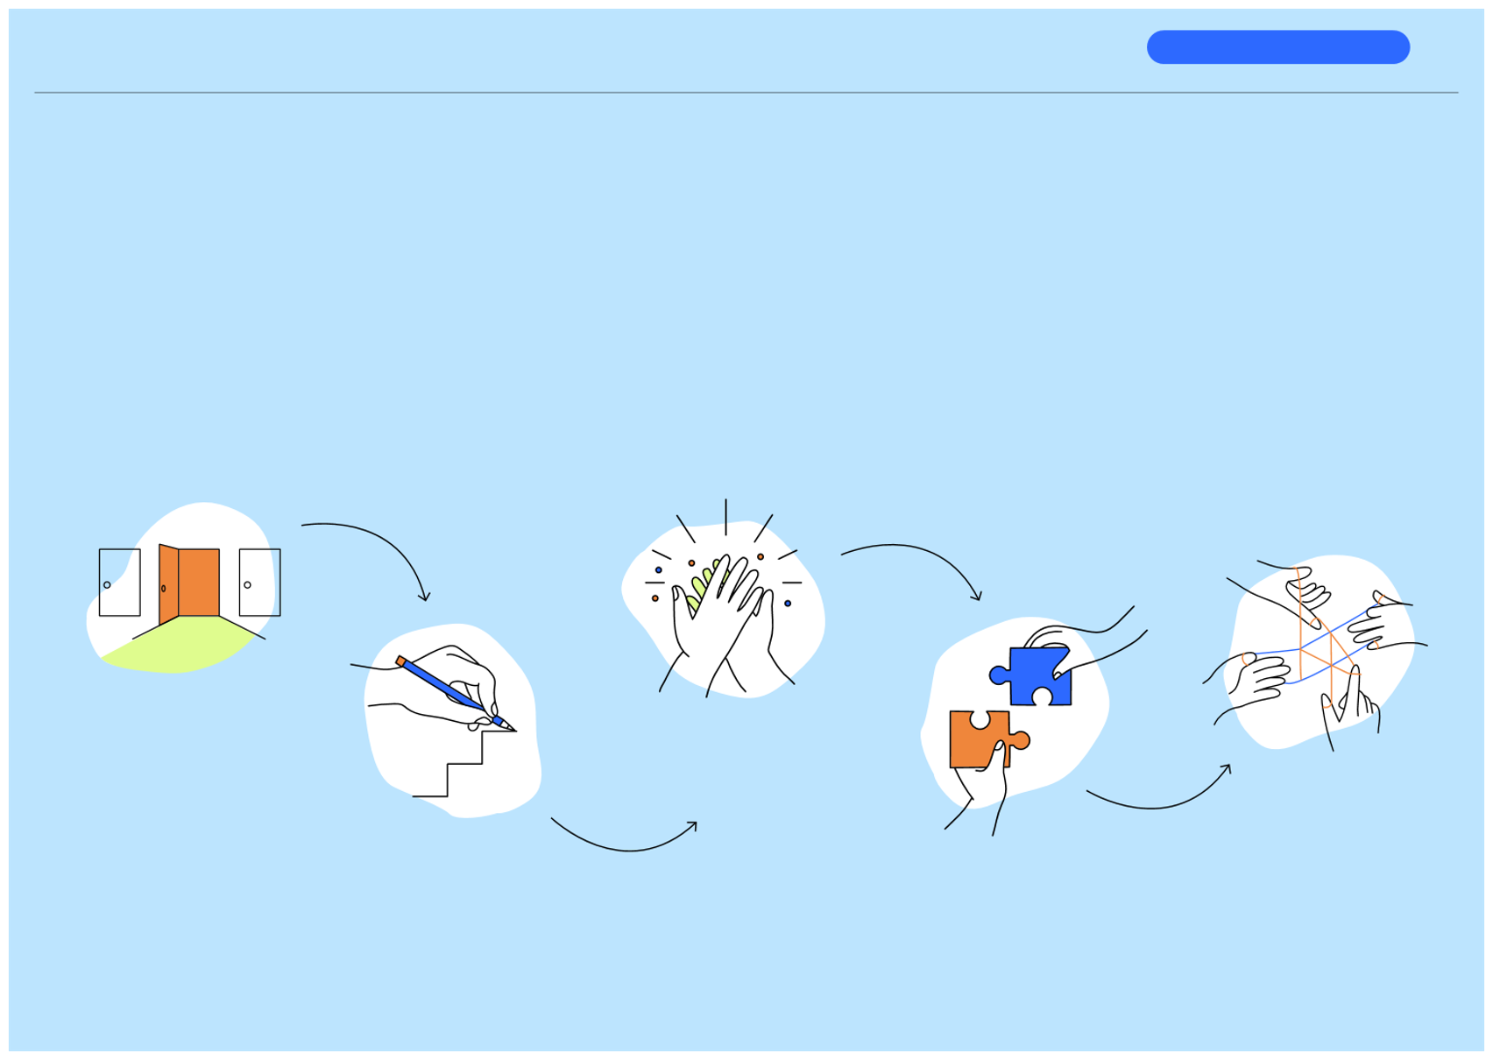
Inspiring the next generation
Part 1 | Understanding the gap
15
There are five steps to a successful engagement approach that results in meaningful connections
These five steps will set the engagement up for success and help make meaningful connections between people within businesses and schools.
We’ll tell you more in the rest of this Starter Kit about each step, what’s involved, and how to succeed, and we’ll share some tips and tools that can help you on your journey.
Step 1 Finding your best entry point
Step 3 Getting to ‘yes’
Step 5 Engaging well with students
Step 2 Starting well
with schools
Step 4 Making it happen

Slide 16
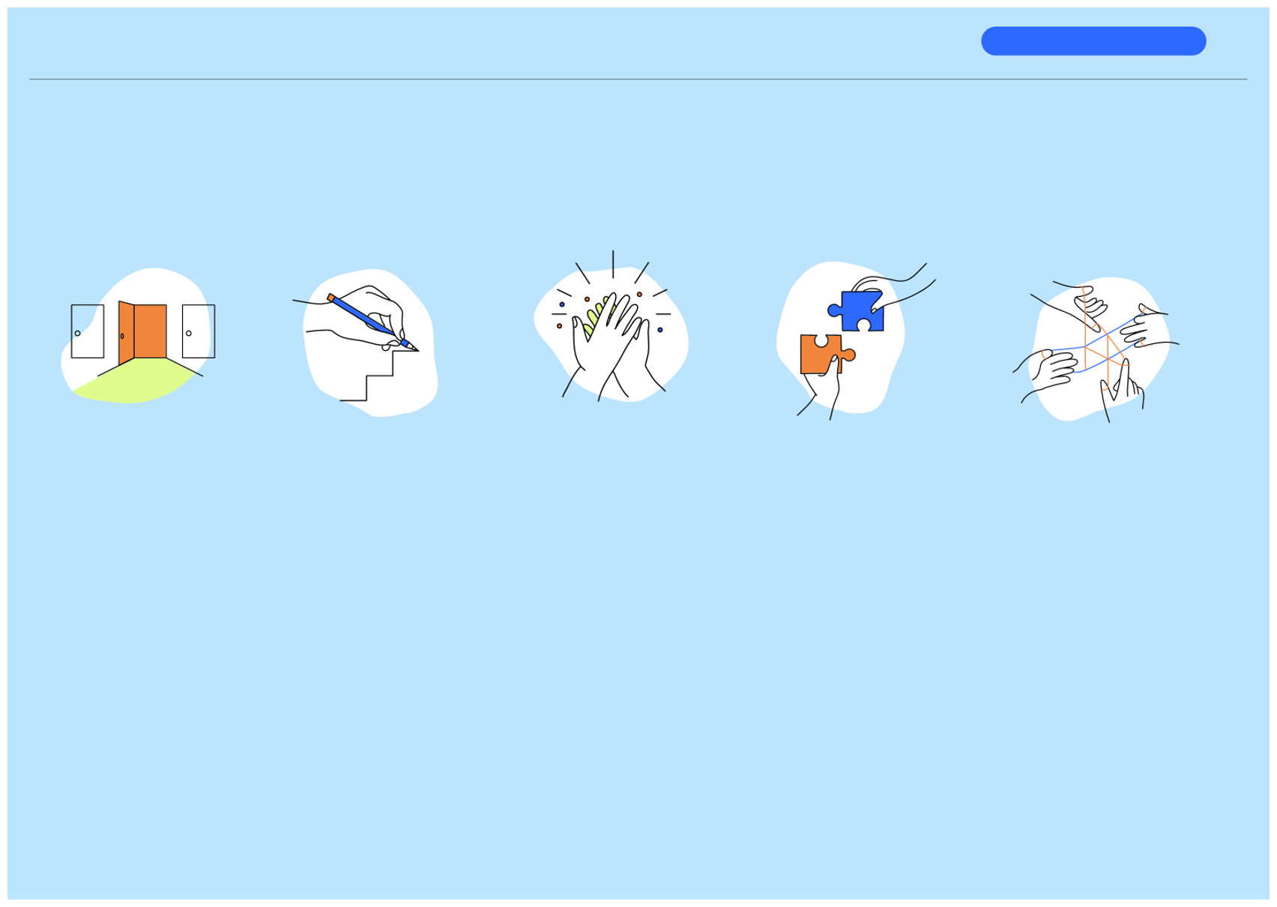
Inspiring the next generation
Part 1 | Understanding the gap
16
Five steps to a successful engagement:
Step 1
Step 2 Starting well
with schools
Step 3 Getting
to ‘yes’
Step 4 Making it
happen
Step 5 Engaging well with students
Finding your best
entry point
This step helps you start well by contributing to existing initiatives and relationships rather than trying to build something completely from scratch. It also helps you work out the best way to connect initially with the school. The result is that you have leverage and clarity on the best entry point to the school.
This step helps you set up your initial interaction with the school for success by taking time to think about what you want to achieve while creating space to understand what the school is trying to do. The result is the school being interested in exploring the partnership further with you.
This step helps you get to a partnership agreement with a school that ensures the relationship is going to be mutually beneficial and which will guide how you work together. The result is you and the school being transparent with each other, including what excites you about what you can deliver and achieve.
This step helps you make the agreed activities happen, thinking broadly and deeply about all the possibilities of what you do together and ensuring that the young people are kept interested and safe through the process. The result is you have a good plan that is achievable and will achieve the shared objectives.
This step helps you focus on the students’ interests, ensuring that how you engage is affirming, inspiring, relatable and engaging for students. The result is that students have a positive experience and are thinking a little differently about the world of work and their place in it.

Slide 17
Inspiring the next generation
Part 1 | Understanding the gap
17
Let’s bust a couple of myths!
Myth
Young people aren’t interested
in the world of work.
It’s the school’s job to prepare
students for the world of work.
Reframe
Young people can’t yet see all the possibilities open to them in the world of work. They don’t know what they don’t know.
Employers are the only ones who know their requirements and the possibilities within their industry; you can play a key role in supporting students to get ready for the world of work.
Students have a lot of choice about work pathways.
Students have limited exposure and choice about work pathways
(or sometimes have the decision made for them) because they don’t
know what is out there and time spent on this is limited.
Schools are slow.
Running a school is challenging and has competing priorities;
schools need time to plan and have limited capacity.
Hosting a site visit is the best way for me to contribute.
Hosting a one-off activity will
benefit students.
There are many ways I can contribute.
Supporting a school over time in a range of different ways has more benefit to students and greater likelihood of the right students finding their way into your industry.

Slide 18

18
Introduction
Part 1 | Understanding the gap Part 2 | Successful Engagement Helpful tools and guidance
Conclusion
Part 2
The 5 steps to
successful
engagement
• • • • •
Step 1 | Finding your best entry point Step 2 | Starting well with schools Step 3 | Getting to ‘yes’ Step 4 | Making it happen Step 5 | Engaging well with students
Engagement Partnership Agreement Workplace Readiness Checklist Engagement Activity Planner
Inspiring the next generation | Starter Kit

Slide 19
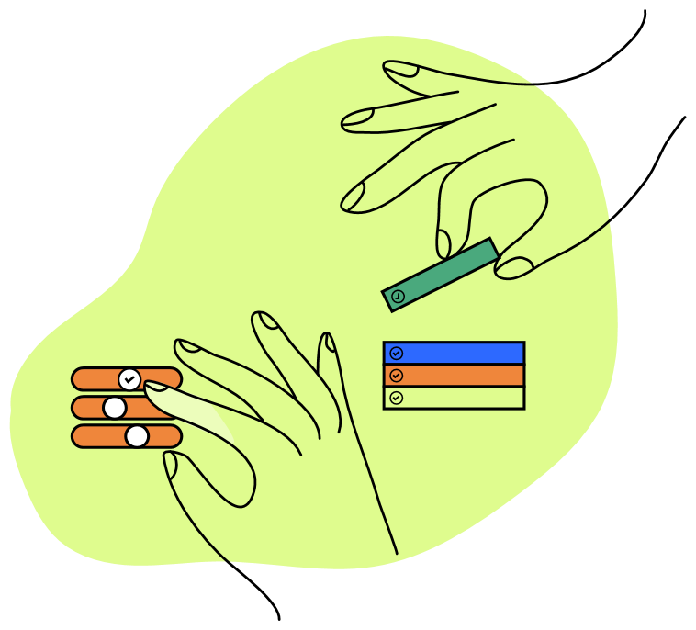
Inspiring the next generation
19
Introduction
Part 1 | Understanding the gap Part 2 | Successful Engagement
Helpful tools and guidance Conclusion
This part of the Starter Kit provides practical advice and tools that you can use, structured around the five engagement steps that, together, maximise the likelihood of meaningful connections.
You may want to start at Step 1 and work from there, or you might already be at a subsequent step and are looking for some guidance.
At the end of the Starter Kit are helpful tools and guidance you can print out or use anyway you like. Do what works for you.

Slide 20
Inspiring the next generation
Part 2 | Successful Engagement
20
Step 1: Finding your best entry point
This step helps you start well by contributing to existing initiatives and relationships rather than trying to build something completely from scratch. It also helps you work out the best way to connect initially with the school.
The result is that you have leverage and clarity on the best entry point to the school.

Slide 21
Inspiring the next generation
Part 2 | Successful Engagement
21
Identifying the key stakeholders
The student’s experience is critical. While you might be engaging primarily with the school, it is all in service of inspiring and benefiting the young people.
We’ll cover some ways to engage positively with students in ways that work for them and recognise their needs, aspirations and talents in Step 5.
SME
SME
Industry/
employer
Students
network
Industry
org
For now, we want to introduce another diverse group of stakeholders: other organisations and people working toward a similar objective. This can include other businesses in your sector, businesses in other sectors, industry associations, regional economic development bodies, jobs and skills hubs, chambers of commerce, etc. The list goes on.
Schools
Step 1 | Finding your best entry point

Slide 22
Inspiring the next generation
Part 2 | Successful Engagement
22
Amplify existing initiatives
There’s a high likelihood that you’re not the first person in your local area to have a go at this.
Your local high school probably has existing programmes and relationships, and there will be others in your network who have previously or are currently contributing to an industry-school engagement programme.
So, reach out. Talk to your business advisors and people in your network. You might only need to have two or three conversations before you’re introduced to the right person to give you all the advice you need and give you that opening to get started.
Even if you are the first, you might find you are best to join up with some other like-minded people. You can share resources and offer your local school a greater diversity of opportunities; they're more likely to respond when you club together. And throughout the process, look to leverage existing knowledge amongst your community.
Often, the hardest part of anything is getting started and a great way to get started is to join up with something that already operating.
For example, a big local employer might already have an established programme with the local high school and have a lot of ready-to-go relationships, processes and templates that they’re happy to share.
Step 1 | Finding your best entry point

Slide 23
Inspiring the next generation
Part 2 | Successful Engagement
23
Five tips for working out where to start.
1
By working with a network of businesses and the school, the students can be exposed to a wider range of roles to give them a fuller understanding of the world of work.
Benefits to students
Find a way into the ‘eco-system’ in your community.
2
Build toward sustainable relationships, rather than a series of one-offs.
3
Work out the school’s structure and rhythm and work to that.
There may already be industry-school relationships, or planned events, or just people who are well-connected and know who you should talk to. Tap into that infrastructure, rather than building your own from scratch. This might include members of the school board or local leaders.
You’re best to invest in relationships with one school before spreading yourself across multiple schools. Collaborating with other employers within your industry; line up together and approach a school with a range of options. This increases the chance the students will find something that appeals to them and makes it easier for the school to engage.
Don’t be too prescriptive with the school. Indicate your interest and invite them to suggest ways you can fit into their world. Terms 2 and 3 are often best for activities. Cold-calling the school’s Principal (without prior relationship) is a low-success strategy; Principals are busy! Consider going via careers advisors or a Board member who’s known to you, or canvass your employees who may have a relationship with a school.
4
Go where the energy is.
5
Keep an open mind about what engagement might look like.
Mistakes to avoid
You need a champion within the school who has a plan, knows how the school operates, and can make things happen. Find that person, and understand how you can help them achieve their goals.
With the three broad categories of Expose, Explore, and Experience, there are many different ways to inspire young people about future career pathways. Be open to the guidance.
Cold calling a Principal with no idea of what the school is currently doing! They may have already invested time in building an industry- partnership programme and you’re best to tap into that. Or you might be one of 30 phone calls they need to return that day.
Step 1 | Finding your best entry point

Slide 24
Inspiring the next generation
Part 2 | Successful Engagement
24
Step 2: Starting well with schools
This step helps you setup your initial
interaction with the school for success by taking time to think about what you both want to achieve for students while creating space to understand each other.
The result is the school being interested in exploring the partnership further with you.
If you haven’t yet found people or groups that are already engaging with schools and students, then this step matters to you.
Students and schools will have things they need to achieve that won’t have crossed your mind. Instead of going in with your detailed plan, go in with an open mind, so you can understand students’ needs and the school’s priorities.

Slide 25
Inspiring the next generation
Part 2 | Successful Engagement
25
Five things to ponder as you prepare for and have your first interaction with the school.
And remember, to slow down. This is just the beginning of a potential partnership. It’s a journey for both of you. It’s ok to start small and build some trust and understanding, and then see what can grow out of that.
Benefits to students
It helps the school to understand the broader value you can offer students, which creates more diverse experiences that help inspire students.
1
Your motivations
2
What you can offer
3
Do some homework about the school
What is motivating you? What do you hope to get from the engagement?
What resources / knowledge can you contribute? Are there a large number of different activities you could support (refer to the inspiration list in Step 3).
What can you find out about the school’s vision, school size and demographics, and existing programmes (from their website or from people you know)?
4
Listen to the school about their motivations
5
Learn how the school
likes to operate
Mistakes to avoid
Rocking up to the school with an offer to talk to students next week and expecting the school to be grateful! Schools need to work out how you fit into their broader strategy and timetable for working with their students.
What are they trying to achieve, what is missing, what would be most helpful?
Types of activities? With other schools? What they’re currently have in place? What works / doesn’t work based on past experience.
Step 2 | Starting well with schools

Slide 26

Inspiring the next generation
Part 2 | Successful Engagement
26
Step 3: Getting to ‘yes’
This step helps you get to a partnership agreement with a school that ensures the relationship is going to be mutually beneficial and which will guide how you work together.
The result is you and the school being transparent with each other, including what excites you about what you can deliver and achieve.
Engagement Partnership Agreement

Slide 27
Inspiring the next generation
Part 2 | Successful Engagement
27
Setting up a partnership agreement
Once you and the school have identified that your aspirations are aligned and that there is a mutually beneficial opportunity to collaborate, it is good practice to put in place a partnership agreement.
This isn’t a legal document; it is a way to be intentional about how you are going to work together, what you each will contribute, your expectations of each other, and the shared goals you are looking to achieve.
Consider who should be part of this partnership agreement. In some cases it might be one-to-one between a school and your business. In other cases, it might be an agreement between one or more schools and multiple businesses.
The content will be whatever works for your unique partnership. This step is about setting realistic expectations and making commitments to each other that can be upheld.
Just remember that starting a multi-party partnership from scratch can be challenging and you might be best to start small and enlist more partners over time.
A good partnership agreement leaves space for the work programme or plan to change as we try things and learn from that.
Step 3 | Getting to ‘yes’

Slide 28
Inspiring the next generation
Part 2 | Successful Engagement
28
Strategising the engagement programme
Any activity that the students participate in is integrated and part of a broader strategy that helps bridge the world of school and the world of work.
Benefits to students
The other part of thisphase, oncethe Partnership
What age group(s) does the school want to focus on?
Agreement is in place,is to strategise together
1
what the detailed engagementprogramme could
One school might see the biggest opportunity as providing Year 13 students with a practical experience of what the world of work looks like, so would be most interested in things like work shadowing or work experience opportunities. Another school might be interested in giving Year 9 and 10 students a taste of the diverse range of work possibilities, so would be most interested in having people from different industries come and present to their students.
look like. In other words, what types of activities are going to be best ones to focus on given each party’s skills, strengths and resources.
The starting point for this conversation will be the goals and aspirations of the school, as articulated in the Partnership Agreement. There are two key questions that then shape any decisions.
2
Does the school want to create one experience for each student, or are they trying to create a sequence of experiences for a group of students?
Mistakes to avoid
Remember the WE3 Continuum (exposure-exploration-experience), and the research that shows that students are less likely to be unemployed if they have at least 4 interactions with employers? This might mean the school is less interested in putting lots of students through one type of activity and creating a sequence or journey of connected activities with a smaller cohort of students.
Launching into an activity without an agreement about how you are going to work together! Your business wouldn’t usually commence working with someone without a plan, contract or purchase order.
Step 3 | Getting to ‘yes’

Slide 29

Inspiring the next generation
Part 2 | Successful Engagement
29
Step 4: Making it happen
This step helps you deliver the agreed activities, thinking broadly and deeply about all the possibilities of what you do together while ensuring that the young people are kept interested and safe through the process.
The result is you have a good plan that is beneficial to students and will achieve the shared objectives.
Workplace Readiness Checklist and Guide
Engagement Activity Plan
The ‘Good Employer Guide’ (developed by Hanga-Aro-Rau) contains lots of useful additional information and practical templates for planning events and managing health and safety. We encourage you to have a look.

Slide 30
Inspiring the next generation
Part 2 | Successful Engagement
30
Agreeing the plan
Once you know the school’s overarching strategic objectives, you’re ready to put your heads together and come up with the ideal activities that meets everyone’s needs.
Identify what activities you’re committing to delivering and confirm who is doing what, when, where and how.
We have two recommendations for you:
1
Keep in mind that activities need to enable progression and be age appropriate
2
Work with the school to link activities to the curriculum
Again, using the WE3 continuum (exposure-exploration- experience), a school isn’t likely to be excited about sending a group of young students along to work experience if they haven’t yet been exposed to the broader world of work through in-class activities or projects. Mapping activities to this model is a useful way of putting the plan into language the school understands and can get behind it.
It’s easier for schools to justify time away from other types of learning if there are curriculum links to the activities. For example, a project related to the world of work that incorporates problem solving, critical thinking, negotiation skills, maths or science or another core part of the curriculum might be easier to get over the line.
Step 4 | Making it happen

Slide 31
Inspiring the next generation
Part 2 | Successful Engagement
31
Planning the event
Ok,so you’veagreedwith the school what the activity is going to be.
You’ve set a date, decided where the activity is going to take place, and worked out what it will involve, the transport logistics, how many people are going to attend, and who is going to invite the students.
And don’t forget these!
There are two other significant considerations, and preparation for this needs to begin well ahead of the activity. These considerations are:
Benefits to students
It keeps them safe and well, meaning they can be fully present and immerse themselves in the opportunity to learn and grow.
1
Safe place
You care about health and safety and the wellbeing of your people and visitors. You have established protocols and risk management frameworks, but may not have experienced having a large group of students visit your business.
2
Safe people
There are stringent legal requirements surrounding people who work with or are in sole charge of young people, and things like Police checks and parental consent are necessary parts of the preparation process. It might feel a bit strange to have to provide a Police check but it’s a really important part of how we collectively keep young people and your people safe. The school can help you with this, as they know how the processes work.
Mistakes to avoid
Thinking that having a group of students visit your workplace will be a piece of cake! Your standard health and safety systems won’t be designed for this type of visitor and may not perform as you hope. Also, students respond to people they can relate to; they need to see themselves in the people they engage with at your workplace.
At the back of this document you will find some helpful tools and guidance. These include:
Workplace Readiness Checklist & Guide: this tool helps you ensure you have a safe place and safe people.
Engagement Activity Planner: this tool helps you identify which part of the WE3 continuum and which activities to focus on.
Step 4 | Making it happen

Slide 32
Inspiring the next generation
Part 2 | Successful Engagement
32
Step 5: Engaging well with students
This step helps you focus on the students’ interests, ensuring that how you engage is affirming, inspiring, relatable and engaging for students.
The result is that students have a positive experience and are thinking a little differently about the world of work and their place in it.

Slide 33
Inspiring the next generation
Part 2 | Successful Engagement
33
Remembering who this is about
Wow, we made it to the big event. You’ve established a great relationship with your local school and you’ve made arrangements for your first activity together. It’s been a bit of work to get to this point but you’re excited and ready to go.
Now you need to think about delivering an experience for the students that is inspiring, affirming and value-adding to the young people.
Step 5 | Engaging well with students

Slide 34
Inspiring the next generation
Part 2 | Successful Engagement
34
Eight tips for engaging well with students
Benefits to students
They are able to fully engage with what they see and hear and can take on a different perspective about the world of work.
1
2
Make it welcoming.
Make it diverse.
3
Make it visual, tactile and interactive.
First impressions count. Cultural context, a warm welcome and a smile goes a long way. Think about how you are welcoming the students. You don’t want their first experience to be a telling off for standing in the wrong place or blocking a walkway.
A good rule of thumb is to have three people from your organisation speaking or engaging with students, with a mix of role levels, role types, age, gender, ethnicity, etc. It removes barriers to engagement and makes the delivery more interesting and relatable.
In addition to talking, use photos, use videos, have props or display items to play with, move around different spaces, have an interactive activity, have a competition, etc. Ask questions of the students. There is so much content online; you can probably find a good 5 minute overview video of your industry that will make it more interactive.
4
Make it age-appropriate.
5
Make it interactive.
6
Make it fun.
Adjust your language for the age-level. Find out from their teacher/s what they already know or don’t know. Drop the industry jargon and explain it in terms they will understand. You can test that ahead of time; practice on your own child / grandchild or that of a colleague.
Have you ever asked a group of young people if they have any questions and you get that complete silence? You were probably no different at that age. So don’t do that; instead, give the students a discussion topic and ask them to have a conversation in a small group and then share back.
You could ask the students what the weirdest or most surprising thing is they have noticed about your business. You could do a little quiz at the end and offer a prize for the winners. Anything to bring in some fun.
Step 5 | Engaging well with students

Slide 35
Inspiring the next generation
Part 2 | Successful Engagement
35
7
Make it interesting.
8
Make it encouraging.
Be enthusiastic and passionate. What are some quirky or interesting aspects of your industry? What are some hilarious or memorable stories? “Do you want to hear the time we made an ... for a movie star?”.
Remember, the young people have stepped well outside their comfort zone by engaging with you. Commend them for that and find ways to affirm their ideas and contributions. “That’s a great question”, “What did you like or dislike from this experience?”, “I’m impressed with how quickly you’ve picked this up”, “How might this help you decide what choices you’ll make?,” “What skills or characteristics would you bring?” etc.
Mistakes to avoid
Just rocking up and having a yarn! You might have a good story, but if you don’t present it well and make it relevant, then the students won’t hear the story. They’ll just seen an adult talking at them.
Step 5 | Engaging well with students

Slide 36
36
Introduction Part 1 | Understanding the gap Part 2 | Successful Engagement
Helpful tools and guidance Conclusion
Helpful tools & guidance
Engagement Partnership Agreement Workplace Readiness Checklist and Guide Engagement Activity Planner
Inspiring the next generation | Starter Kit

Slide 37

Inspiring the next generation
Helpful tools and guidance
37
Engagement Partnership Agreement (possible structure)
Print and use your way
1.
2.
Name the parties
E.g. “Partnership Agreement between xxx and yyy.”
Write a sentence or two on the context of the partnership
E.g. “[School name] is the main high school in our region, and [your company] is a long-standing member of our community. This Partnership Agreement outlines the ways in which we will work together to positively introduce students to the world of work.”
3.
State what each party wants to accomplish through this partnership
Include desired outcomes, e.g. students obtaining a job in your organisation, being supported in vocational training, or work experience. Is the aim to expose students to opportunities by talking with them and sharing stories or providing hands-on activities in the workplace?
E.g. “For [School name], this partnership is an opportunity to...For [your company], this opportunity is an opportunity to …”
4.
Identify some values and principles that will underpin how you work together
Tip: starting with the school values for this part might be a good move as it centres it around what the school is trying to achieve and how they support their students.
E.g. “The following four values will guide how we work together …”
5.
Identifying roles, responsibilities and what each party will contribute
This can include simple things like logistics; who ensures the students are transported to a work site, who pays for lunch, etc.
E.g. “[School name] will be responsible for [state activities / functions] and will contribute the following resources”.
6.
Cover the basics of confidentiality and data protection
E.g. “We acknowledge that by working together we will have access to confidential information (e.g. identity of young people) and will not share their personal information, photos or other information with third parties, without the express permission of their parent or caregiver.”
Step 3 | Getting to ‘yes’

Slide 38
Inspiring the next generation
Helpful tools and guidance
38
Workplace Readiness Checklist
Print and use your way
SafePlace | Tipsformanaginghealth,safetyand wellbeing
Consider these 6 factors tomanage health,
safety and wellbeing for everyones benefit:
Is your site the best location for the activity?
Is there a natural limit on group size?
What does health and safety induction look like?
Consider whether a site visit is an important part of the objective, and whether the objective could be achieved just as well in a more easily controlled environment (e.g. the school, or an office building, etc.).
Instead of a visit from 30 students, maybe it makes more sense from a health and safety perspective to have smaller groups of, say, 5 students at a time.
Consider whether it happens on site, or whether some of the induction is better to take place in advance. Remember that there is a lot going on for the students as part of a site visit and it may be hard for them to take it all in.
Have you tailored your health and safety systems and induction for the audience?
Are you keeping your people safe?
How can you share your approach to health and safety with the young people?
You’re probably used to hosting people from your industry who are very aware of the specific risks. Many students may have never experienced anything like your workplace and have little understanding of the hazards and risks. Is your business a safe place for the students’ to visit?
It would be very easy for one of your people who is carrying out a routine task to be distracted by or worried about the safety of the students. You might need to pause certain activities, or bring in other controls to ensure your people aren’t placed in an unsafe situation.
Thinking through health and safety risks and working out how to manage those might be a completely new thing for students and is an important part of the world of work. You could run an activity where young people do a risk assessment based on what they have seen – you might get some great ideas!
Step 4 | Making it happen

Slide 39
Inspiring the next generation
Helpful tools and guidance
39
Workplace Readiness Guide
Print and use your way
SafePeople | Managingyouthsafety
Consider these 2 factors:
1
Don’t take it personally.
Benefits to students
It keeps them safe and well, meaning they can be fully present and immerse themselves in the opportunity to learn and grow.
This is a legal requirement, and it’s about keeping young people safe. It also keeps your business and your people safe. So don’t be awkward or make a big deal of it. Signal to the school that you expect this to be part of the process and that it is no big deal.
Mistakes to avoid
2
Thinking that having a group of students visit your workplace will be a piece of cake! Your standard health and safety systems won’t be designed for this type of visitor and may not perform as you hope. Also, students respond to people they can relate to; they need to see themselves in the people they engage with at your workplace.
Leverage the school’s knowledge.
They work with young people day-in / day-out, and will have established processes and protocols. Ask what those are, and how you can fit into their system.
Remember, there’s some useful guidance in The ‘Good Employer Guide’
Step 4 | Making it happen

Slide 40
Inspiring the next generation
Helpful tools and guidance
40
Engagement Activity Planner
This tool helps you to be deliberate about what you’re trying to achieve while considering the aspirations of the school and the students. You might find inspiration in some of the activities below, or they might spark some other ideas.
Print and use your way
Work Exposure Activities
Work Exploration Activities
Work Experience Activities
Be part of a lineup of several people from business talking about interesting things about their profession.
Supporting the school to develop short videos that showcase a range of role types within the industry or region.
Being available as an interview participant for a student research project into what it’s like to work in your business or industry, what factors shape the world of work.
Sponsoring a work-related award at the school, e.g. for stand-out students placed into vocational education.
Helping the school shape the curriculum delivery to align with the world of work.
Participate in a school project that explores how the demographics or skills of your industry’s workforce is changing and why.
Share information about the various roles and activities within your business as part of a careers event.
Presentations at school about your industry,
your business, and your career.
Hands-on activities related to a trade (e.g.
learning how to use land surveying equipment).
Supporting young people with CV
preparation and interviews.
Describe the characteristics that employers
are looking for when hiring.
Showcasing / demonstrating new equipment
or technology used in your business.
In-class presentation showing how academic
subject is used in your business (e.g. how geometry is used, or maths, physics or chemistry, etc.).
Team-based research project related to your business or industry (e.g. how to minimise material waste for a commercial process).
Working with your industry colleagues to develop real-world problems for young people to solve.
Work experience placement, internships
or work shadowing.
Student-led forum to get advice career advice / coaching from businesses.
Helping students to create a portfolio of their work-related skills and capabilities.
Coaching / mentoring of Year 13 students.
Provide support to a region-wide, problem- focussed design challenge (e.g. how to reduce building waste in our region).
Step 4 | Making it happen

Slide 41
Inspiring the next generation
41
Conclusion
The world of school doesn’t operate the way you assume it might, and the world of work doesn’t operate the way that schools assume it might. There is a gap, and the result is that students leave school with little awareness, understanding and excitement about the world of work.
It doesn’t have to be this way. Industry is uniquely placed to bridge this gap because of its intimate knowledge of the world of work.
Getting started can feel daunting, but it doesn’t need to be. By following the steps in this Starter Kit, you are well on your way to navigating the nuances of the world of school. A little bit of intention about how to engage with the school and students can make the world of difference.
Our closing remarks?
You are in a unique position to inform and excite young people about the world of work, and to help prepare them to be the future workforce that you need.
This Starter Kit is a guide, a starting point. Adapt the approach to suit your context; use it flexibly. And importantly, share your learning with others as you have a go.

Slide 42
Inspiring the next generation
42
concove.ac.nz
www.thinkplace.co.nz

